Slide 1
robot assistants

Slide 2
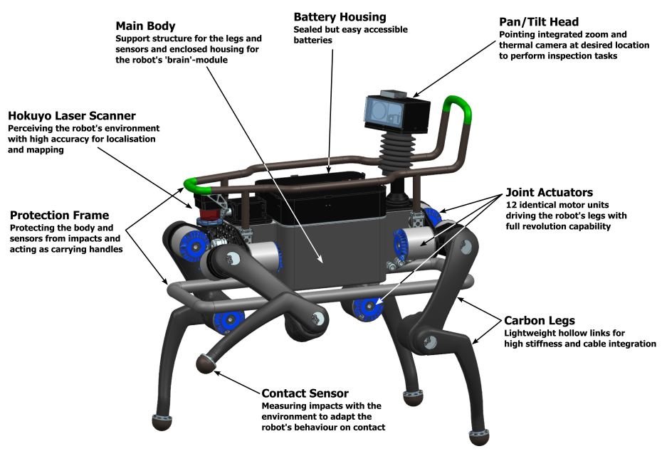
ANYmal
The legged robot ANYmal can support disaster relief teams with safer search and rescue operations.
Thanks to incorporated laser sensors and cameras, the robot can perceive its environment to continuously create maps and accurately localize. Based on this information, it can autonomously plan its navigation path and carefully select footholds while walking.

Slide 3
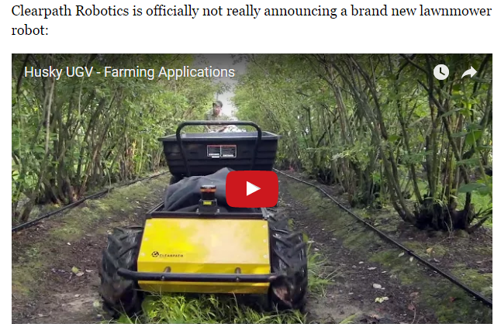
Husky – Research Assistant
Contains Cameras, LIDAR, GPS
For assisting field research.
Lidar is a surveying method that measures distance to a target by illuminating that target with a pulsed laser light, and measuring the reflected pulses with a sensor.

Slide 4
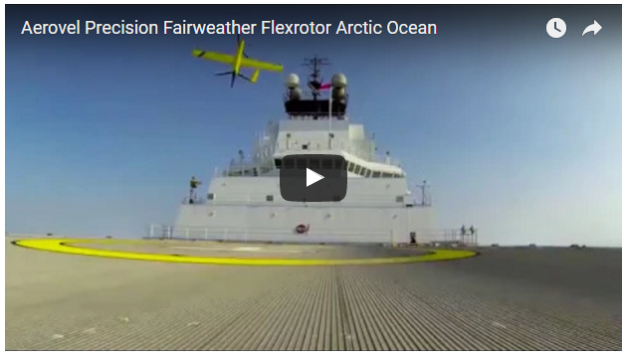
UAV (Unmanned Aerial Vehicle)
Video from the aircraft became the most compelling show onboard, especially for the seasoned ice pilot responsible for navigating the ship to its targets. Video was also followed with keen interest by web viewers in Alaska and the “lower 48,” streamed in real-time through the boat’s satellite link.
Occasionally their view was clouded by fast-forming fog – a common problem that, together with the cold and distance from help, makes manned-aircraft reconnaissance a daunting proposition over the Arctic. Low visibility would have put a helicopter’s crew in danger, but Flexrotor simply returned to the fog-shrouded ship, landed automatically, and waited for the skies to clear. The whole reconnaissance operation was much safer and more practical than any manned-aircraft option, and less costly.

Slide 5
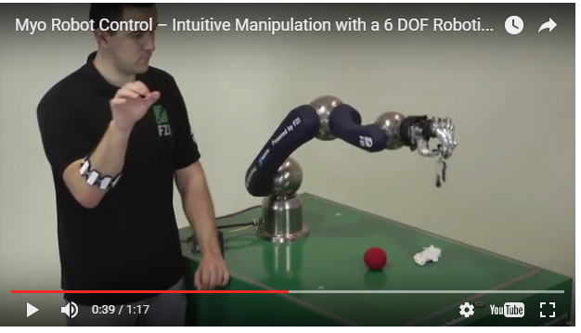
Myo gesture-recognition armband
6DoF Schunk PowerBall LWP4 robotic arm and SVH anthropomorphic hand are controlled over Bluetooth using the Myo armband. Both position and orientation of the Myo sensor are used to move the arm and place the hand close to the object of interest.
Myo’s EMG sensors detect muscle activity of the user’s grasp, release gestures and trigger grasp motion of the robotic hand. Collisions with the table are avoided by using dynamic kinematic restrictions, so that the hand always stays over the table surface. The system can quickly adapt to work with any user in under one second thanks to the very fast calibration of the Myo armband.

Slide 6
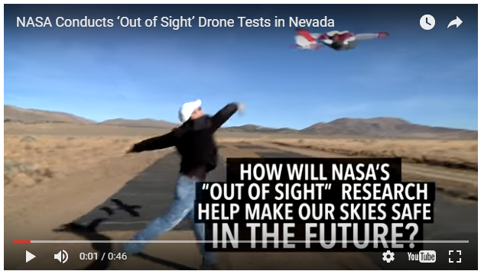
NASA’s Out of Sight Drone
The “out of sight” tests, led by NASA in coordination with the Federal Aviation Administration and several partners, were the latest waypoint in solving the challenge of drones flying beyond the visual line of sight of their human operators without endangering other aircraft. They were part of NASA’s Unmanned Aircraft Systems (UAS) traffic management (UTM) research platform.
UTM’s Technical Capability Level Three testing is planned for January 2018 and will involve evaluating tracking procedures for managing cooperative and uncooperative drones to ensure collective safety of manned and unmanned operations over moderately populated areas. Technical Capability Level Four, planned for 2019, will involve higher-density urban areas for autonomous vehicles used for newsgathering and package delivery, and will offer large-scale contingency mitigation.

Slide 7
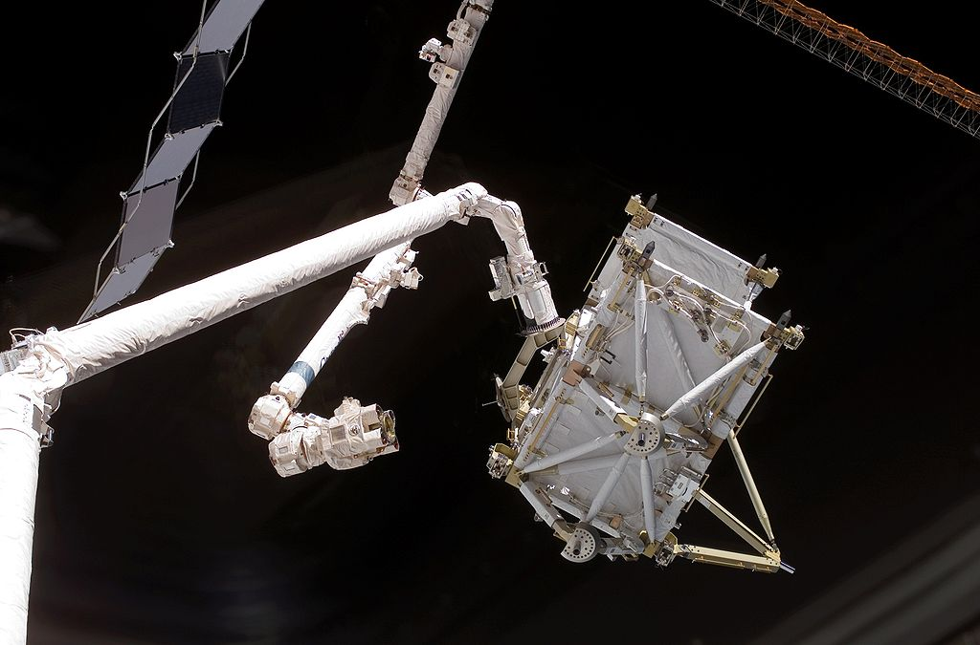
Canadram
Robotic Arm installed with space shuttles to deploy, maneuver and capture payloads.

Slide 8
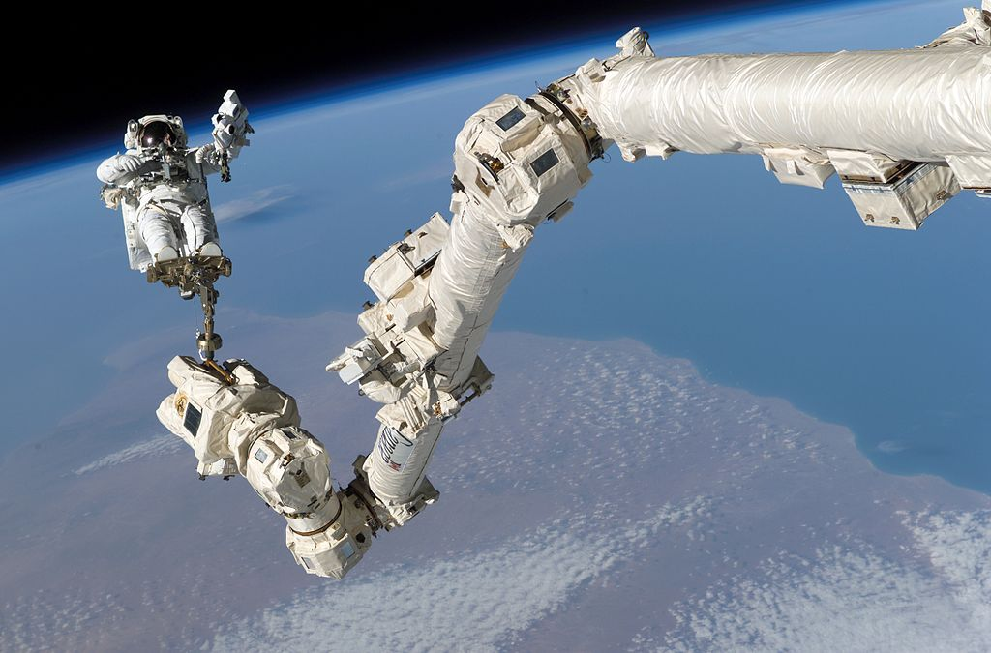
Mobile Servicing Systems
Robotic arm aids in servicing and maintenance of International Space Station.

Slide 9
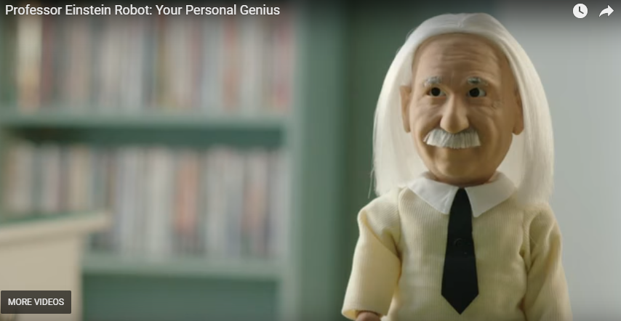
Prof. Einstein
Professor Einstein is a teaching robot that makes playing educational games about science and math appealing and fun. One of the qualities that makes this robot unique is its human-like appearance, expressions, and gestures.

Slide 10
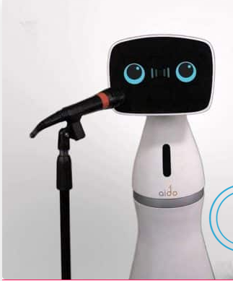
Aido
Has in-built projection screen
Home Integration

Slide 11
Buddy
Speak multiple languages
Developed using Unity 3d SDK. So, one can add customizable features to the robot.

Slide 12
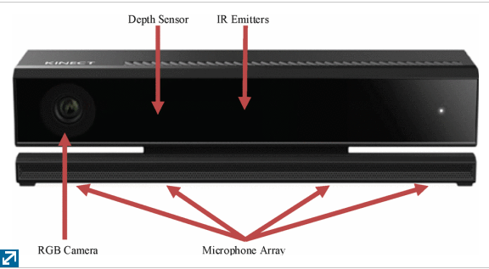
Kinect Sensors

Slide 13
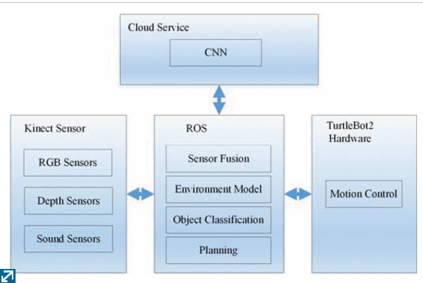
Framework of a Shopping Assistant

Slide 14
The Future
Incorporating Deep Learning to make it personal for every day user.
https://ideaing.com/ideas/the-best-robot-personal-assistants

